Slide 1
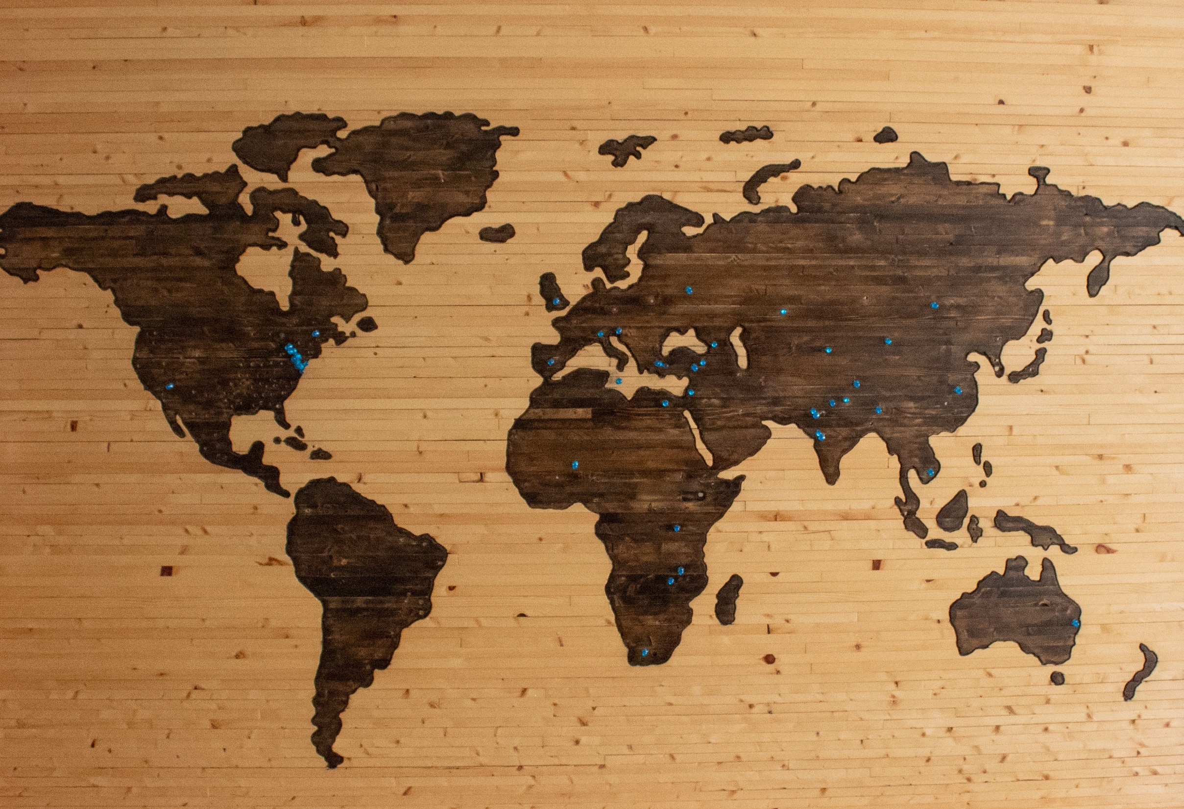
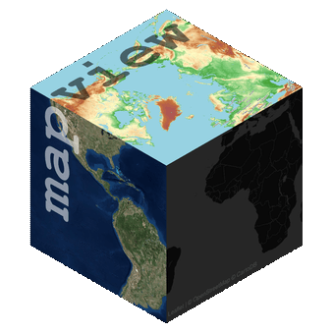

Introduction to Spatial Data in R
with sf and mapview, in RStudio
David Harshbarger
2019-02-28

Slide 2
1
What is spatial data, and why R?
2
Tutorial and use cases
Resources for later
3

Slide 3
1
What is spatial data, and why R?
2
Tutorial and use cases
- only a brief discussion of mapmaking in R
Resources for later
3

Slide 4
1
What is spatial data, and why R?

Slide 5
Why R?

Slide 6
Why R?
Keep statistical analysis and spatial analysis in the same workflow
This is not just convenient – it makes your work more easily reproducible (by others, but also by you!)
R is open-source, and…

Slide 7
Why R?
Keep statistical analysis and spatial analysis in the same workflow
This is not just convenient – it makes your work more easily reproducible (by others, but also by you!)
R is open-source, and…
R is really good with spatial data!

Slide 8
So what is spatial data?

Slide 9
Building blocks of spatial data

Slide 10

Building blocks of spatial data
Geometry

Slide 11
Building blocks of spatial data
Geometry
Attribute data

Slide 12

Building blocks of spatial data
Geometry
Attribute data
Projection

Slide 13
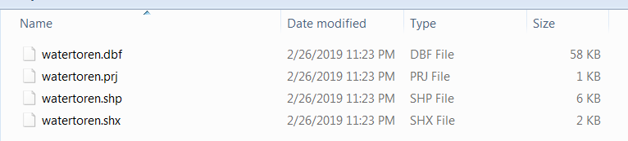
An ordinary shapefile

Slide 14
Shapefiles are actually several files, each containing different aspects of spatial data

Slide 15
But in R, we use the sf
package to employ sf objects,
which are just data frames with a geometry column

Slide 16
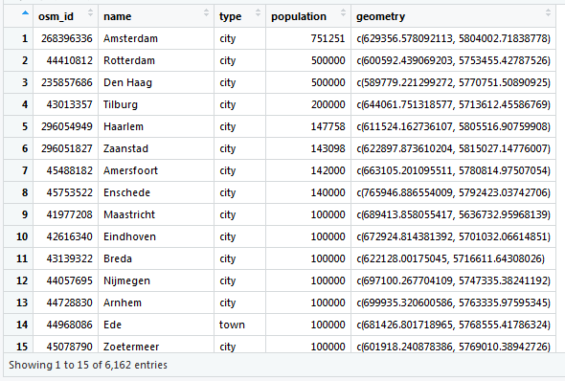
sf objects are data frames

Slide 17
sf objects are data frames

Slide 18
sf objects are data frames
Note that this particular set of geometry data doesn’t look like lat/long coordinates… because it’s not anymore! The spatial data have been projected

Slide 19
What actions can we take on spatial data with R?

Slide 20
What actions can we take on spatial data with R?
Just about anything you would
with a normal dataframe

Slide 21
What actions can we take on spatial data with R?
Just about anything you would
with a normal dataframe
As well as some new geoprocessing tricks, thanks to sf

Slide 22
What actions can we take on spatial data with R?
Raster-to-polygon
Project
Compute area
Dissolve
Buffer
Intersect
Interpolate values
Clip
Spatial join
Smooth features
Fill in holes
Convex hull
Drop “crumbs”
Reduce to centroid

Slide 23
Conveniently, all geoprocessing functions in the sf package begin with the prefix st_
st_as_sf
st_area
st_buffer
st_centroid
st_combine
st_contains
st_covers
st_crosses
st_crs
st_set_crs
st_difference
st_distance
st_interpolate_aw
st_intersection
st_join st_make_grid
st_nearest_points
st_read
st_sample
st_touches
st_write

Slide 24
Conveniently, all geoprocessing functions in the sf package begin with the prefix st_
TO NAME A FEW

Slide 25
2
Tutorial and use cases

Slide 26
2
Tutorial and use cases
We will work through five steps:
Read in spatial data to R
Explore visually
Manipulate the geometry & projection data
Analyze the attribute data
Write the output to a shapefile

Slide 27
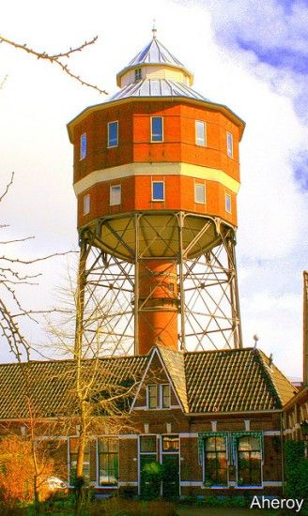
2
Tutorial and use cases
To the code!

Slide 28


Slide 29

Be mindful of coordinate reference systems
Never use geoprocessing functions on unprojected lat/long coordinate data

Slide 30
3
Resources

Slide 31
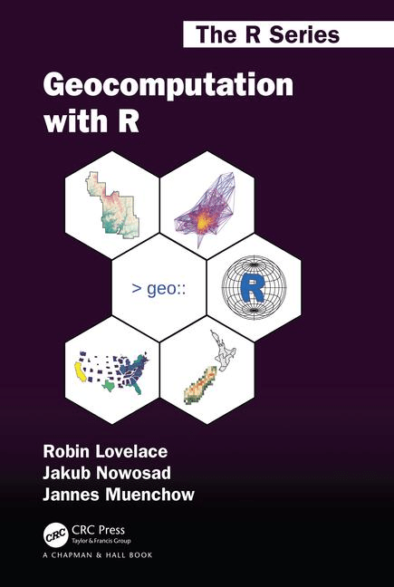
Free web-based book available at
https://geocompr.robinlovelace.net/

Slide 32
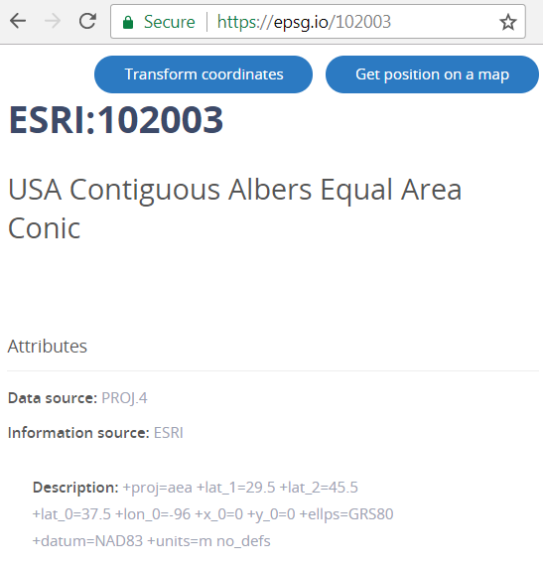
look up codes for projections
(EPSG codes) at
https://epsg.io/

Slide 33
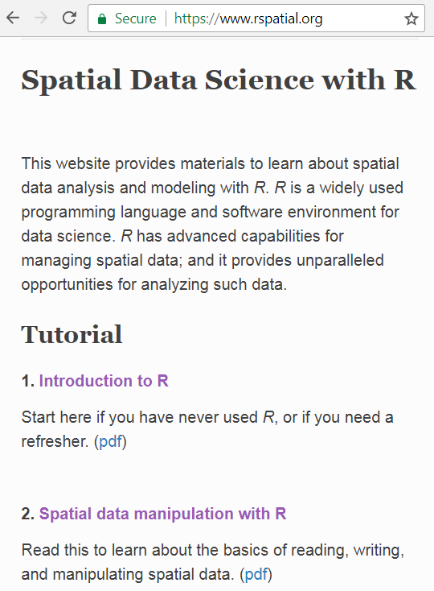
Tutorials and
vignettes at
rspatial.org

Slide 34
Check out the R package tigris, which imports US government geometries at the command line

Slide 35
https://github.com/rstudio/cheatsheets/blob/master/sf.pdf

Slide 36



#rstats
Online communities
are your friend
#rspatial

Slide 37
Introduction to Spatial Data in R
with sf and mapview, in RStudio
David Harshbarger
2019-02-28
icons courtesy of flaticon.com

Slide 38
Bonus round: things to Google
vector vs. raster data
projection vs. datum
simple features
OpenStreetMap
Well-known text (WKT)
GeoJSON

